Slide 1

Children in Need in Somerset: Trends, Pressures and Implications
Gbemi Akindeji

Slide 2
Data & Scope
Source: Children in Need Census (DfE)
Time period: 2013–2025
Geography: Somerset (pre- and post-unitary)
Measures used:
Children at any point
Started / Ended cases
Children in need at 31 March
Awaiting assessment
Episodes of need at any point
Episodes of need ending in the year
Children starting an episode of need in the year
Episodes of need starting in the year

Slide 3
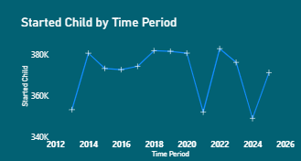
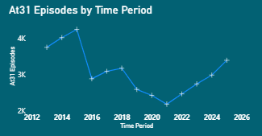
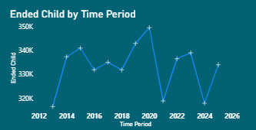
Big Picture 1: Is pressure rising or falling?
Children in need at 31 March (Somerset, over time)
Flow Through the System (Core Insight)
Indicates rising and sustained pressure
The number of open cases at year-end has increased steadily
More cases are starting than ending
The gap has widened in recent years

Slide 4
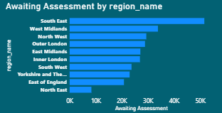
Big Picture 2: Is pressure rising or falling?
Key Issues Summary
Assessment Delays
Growing number of open cases
Slower case closures
Increasing assessment waits
Longer case durations
Risk of sustained future pressure
Waiting numbers have increased
Delays create safeguarding and escalation risks

Slide 5
Data Analysis flowchart
Extract and Cleaning with Python
Database Design with SQL(Loading Data)
Transformation with Power BI

Slide 6
Final Thought
Solutions & Focus Areas
Key Takeaway
Now (0–6 months):
Clear assessment backlogs
Improve case review discipline
Next (6–18 months):
Strengthen early help and step-down
Target repeat cases
Later (strategic):
Workforce stability
Multi-agency demand reduction
Somerset’s Children in Need data shows rising pressure driven by slower case closures, growing open caseloads, and assessment delays, particularly following the move to a unitary authority.

Slide 7
THANK YOU!

